Slide 1

National Wound Care Strategy Programme An Update
Dr Una Adderley PhD, RN, DN, QN
Director : National Wound Care Strategy Programme

Slide 2
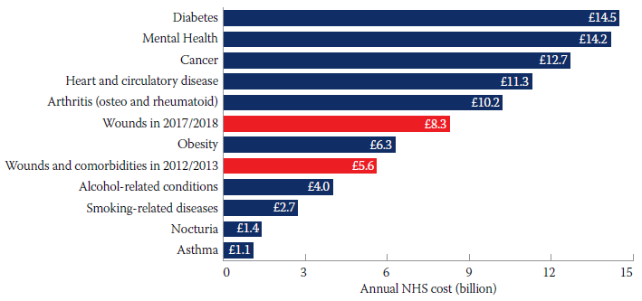
The Challenge
The cost of wound care in England is high and continues to rapidly increase.
Too few patients are receiving evidence-based care (unwarranted variation).
Too many wound care pathways are poorly organised.
There is a lack of data and information to inform quality improvement.
Burden of illness league table at 2017/18 prices
Guest, J. F. (2020). "Burden of wounds to the NHS: what has changed since 2012/13?" Wounds UK 17(1): 10-15.

Slide 3



NWCSP
Aims and Vision
Clinical Priorities
People
Improve the knowledge and skills of the health and care workforce, patients and carers
Technology
Improve the quality of data and Information
Process
Improve the systems and pathways for the delivery of care
    37% of all wounds and 71% of NHS spend on wound care¹
    5% of all wounds and 7% of NHS spend on wound care¹
    14% of all wounds and 7% of NHS spend on wound care¹
1. Guest, J.F., G.W. Fuller, and P. Vowden, Cohort study evaluating the burden of wounds to the UK’s National Health Service in 2017/2018: update from 2012/2013. BMJ Open, 2020. 10(12): p. e045253.

Slide 4

Evidence
How should we use evidence in clinical practice?
Clinical state, setting and circumstance
Patient preferences and actions
Research evidence
Health care resources
Evidence
Based
Practice
https://www.nationalwoundcarestrategy.net/wp-content/uploads/2022/11/Engaging-with-Evidence-for-Wound-Care-8Nov22-final.pdf
DiCenso, A, Cullum N and Ciliska D (2008) Chapter 2 Implementing evidence-based nursing: some misconceptions. In Evidence-based Nursing. Ed. Cullum N, Ciliska D, Haynes RB, Marks S. Blackwell Publishing, Oxford.

Slide 5
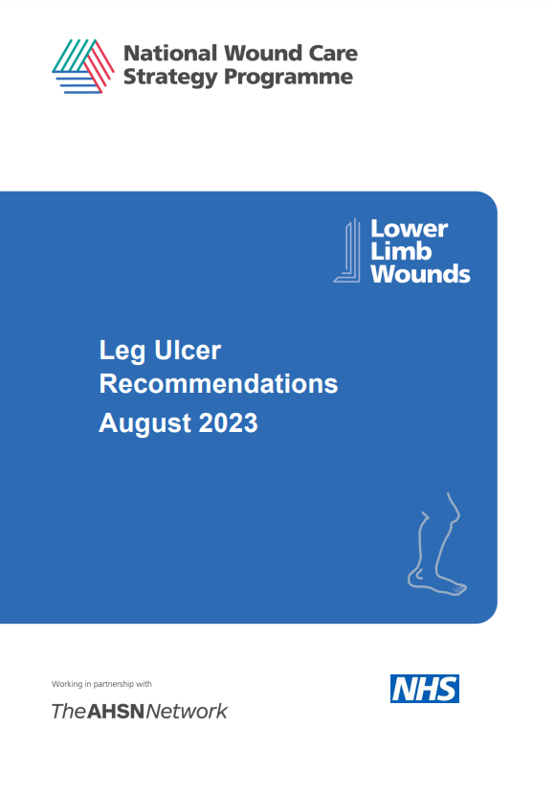
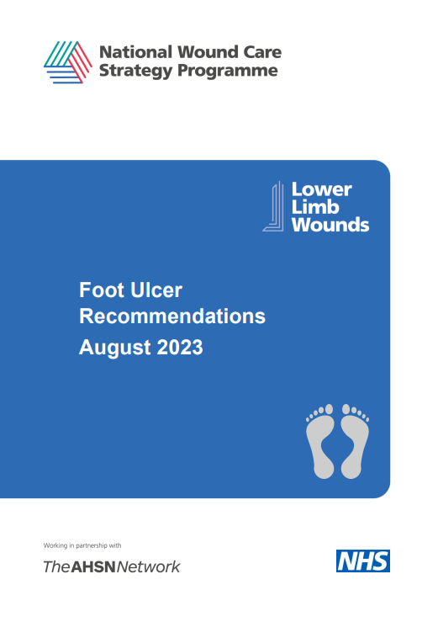


Evidence
Key action 1: Aim for evidence-based good practice

Slide 6

Education and Workforce
How can we improve the knowledge and skills of the workforce?

Slide 7
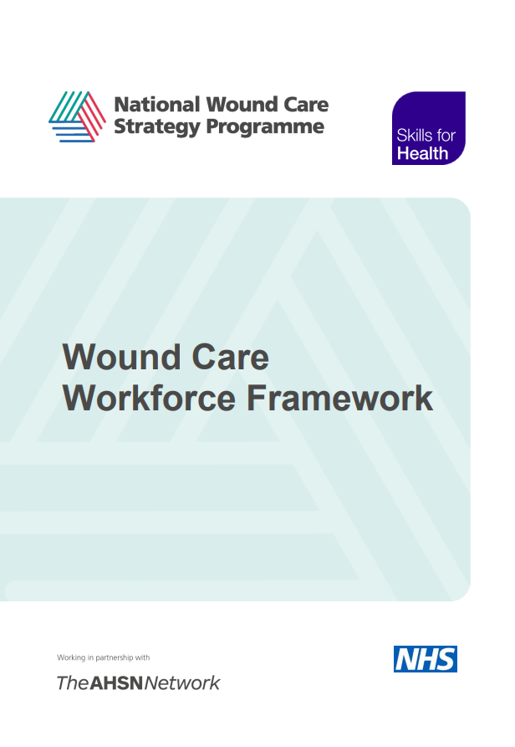
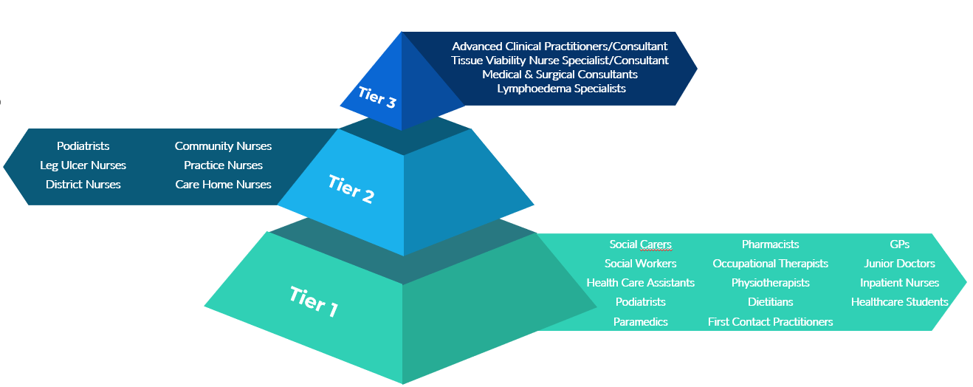
Education and Workforce
Key action 2: Map the capabilities of whole workforce who care for people with wounds.

Slide 8
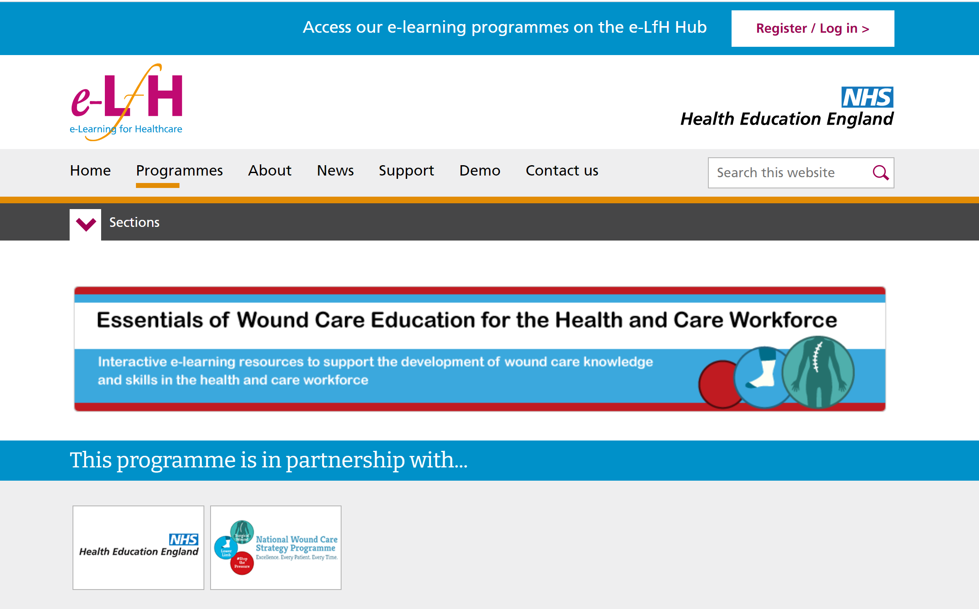

Education and Workforce
Key action 3: Address knowledge and skills gaps in the workforce
Tier 1
Essentials of Skin Care
Essentials of Wound Assessment
Essentials of Digital Wound Imaging
Essentials of Nutrition and Lifestyle*
Essentials of Wound Infection*
Essentials of Leg Ulceration
Essentials of the Foot at Risk
Diabetic Foot Screening
Granulation Game
Essentials of Pressure Ulcer Prevention
Purpose T*
Essentials of Surgical Wounds*
Tier 2
Diagnosing and Managing Wound infection*
Adult Lymphoedema
Vascular Assessment*
Making Differential and Formal diagnoses (Case Studies)*
Foot at Risk
Principles of Managing Surgical Wound Complications
Principles of Managing Open Surgical Wounds
Tier 3
HEI education

Slide 9
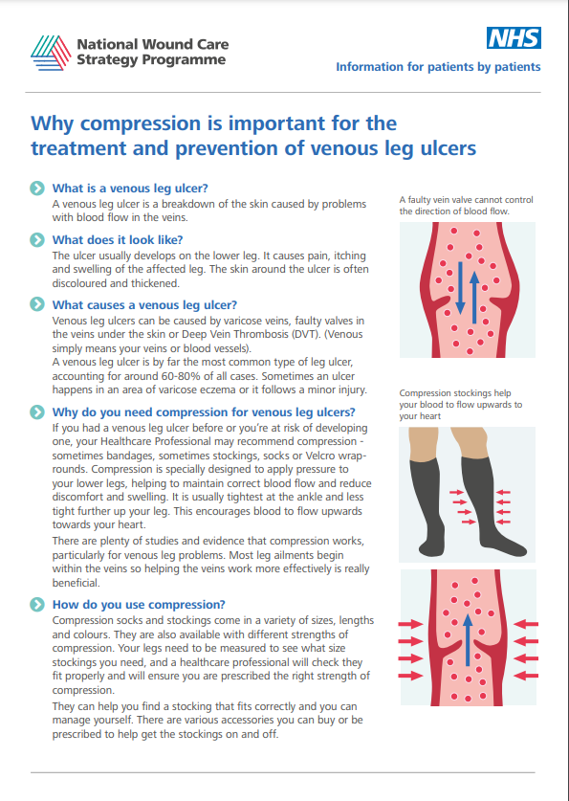
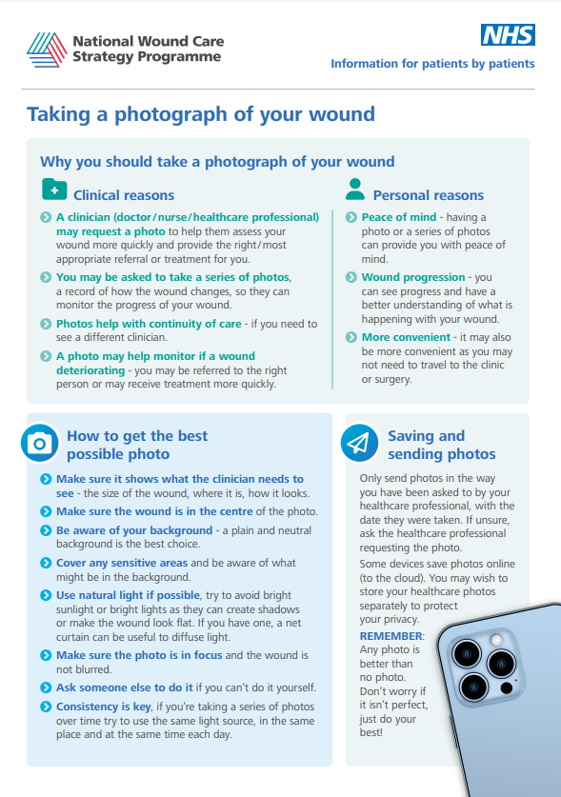
Information for patients and carers
Key action 4: Identify and support opportunities for supported self-care

Slide 10

Digital, Data and Information
How we could use data in wound care
Patient & pathway data
Patient age, gender
Referrals
Diagnosis
Activity volumes
Outcomes
Clinical
  Support point of care
    Continuity of care
    Decision support
    Cohort management
  Audit & Improvement
    To identify unwarranted variation
    To support improvement programmes
    Exploit in surveillance systems
Product data
Wound care products
Equipment
  Commissioning & contract management
  Service Management
  Business case development
  Performance management
Experience data
Patients and carers
Staff
Business
Workforce Productivity data
Staff involved
Activity type

Slide 11
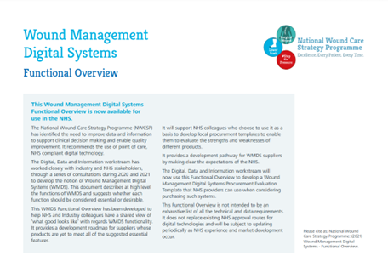
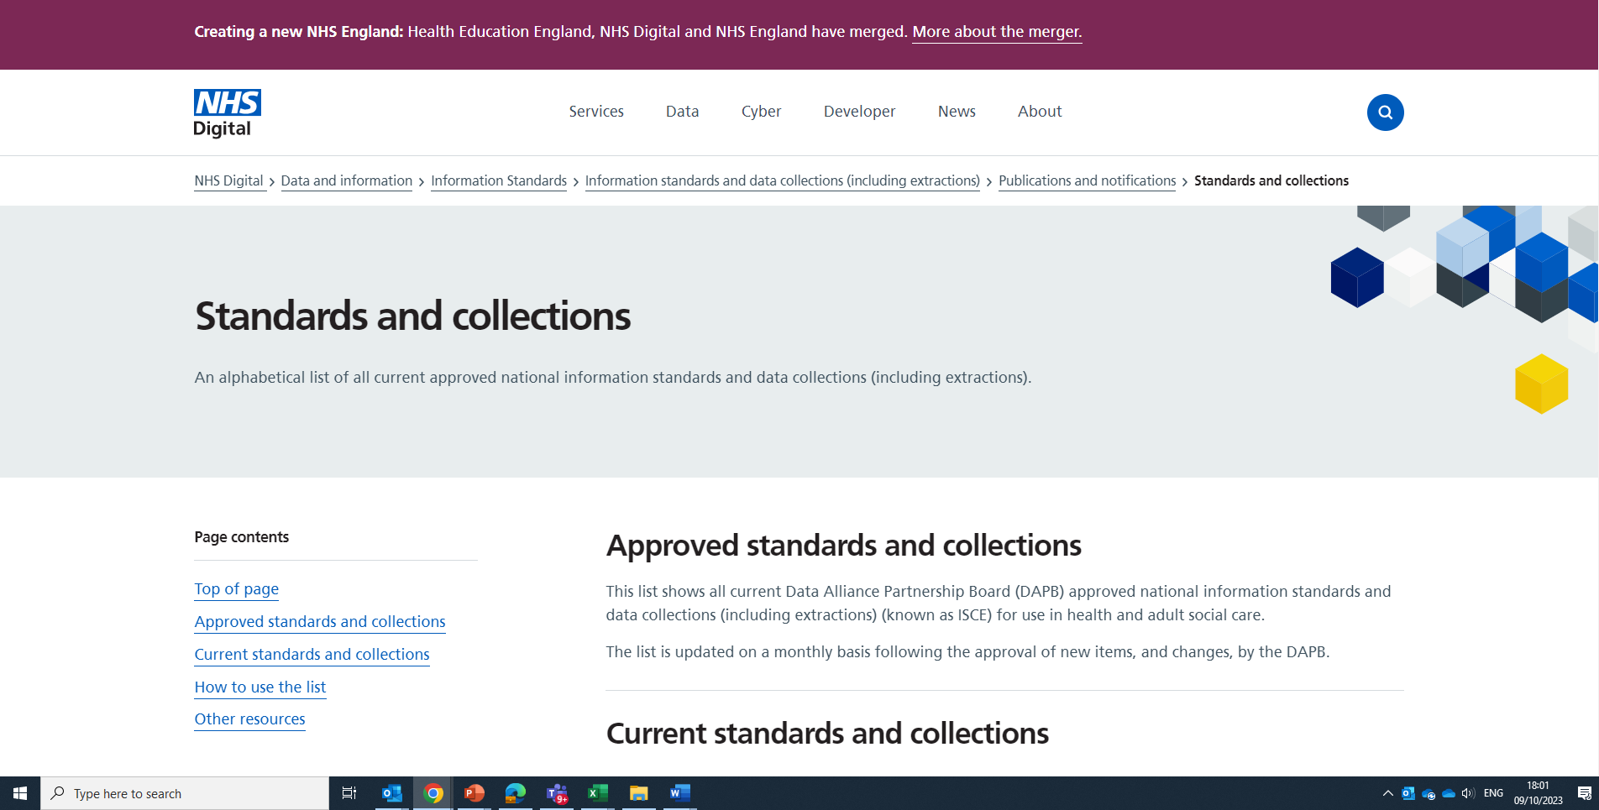

Digital, Data and Information
Key action 5: Optimise digital technology to support good clinical documentation, which results in quality data collection
  Reduce the burden of data collection by improving your digital systems (EPRs, WMDS)
  Support the flow of clinical care delivery (assessment, diagnosis, treatment, ongoing care) and where care is delivered (clinic setting, patient’s place of residence)
  Adopt the Wound Care Information Standard Notice (DAPB4086) to improve your clinical documentation
  Support the capture and sharing of wound images
  Flow data into other systems (EPR to ICS Shared Care Records, EPR to national datasets)
  Support staff to adopt and take advantage of digital systems (e.g., review and manage their caseloads)

Slide 12
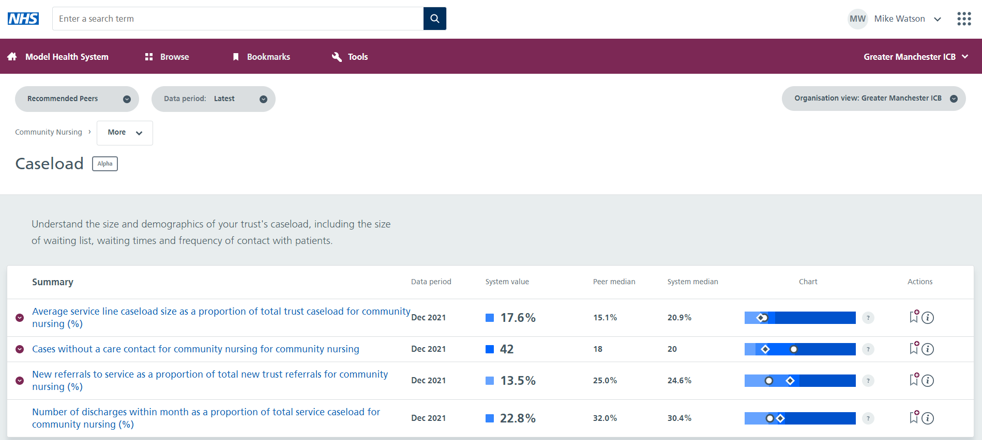
Digital, Data and Information
Key action 6: Use data to improve data
  Work collaboratively with your Business Intelligence teams to develop analytical reports to review your reported activity to spot any discrepancies and gaps versus what you observe operationally.
  Identify where opportunities for improving the quality of your data may lie.
    This may be in your ways of working, digital system configuration, reporting design, user behaviours.
  Work together to improve these factors and increase your confidence in the data.
  Build up your picture of the prevalence, assessment, treatment and healing rates of patients with wounds.
  Share this data at System, Regional and National level to identify further opportunities for improvement.

Slide 13

Digital, Data and Information
Key action 7: Improve information about NHS product use
Review your routes of supply for wound management products
Await publication of national wound product classification system that can be used by all organisations that procure, list or supply wound management products

Slide 14
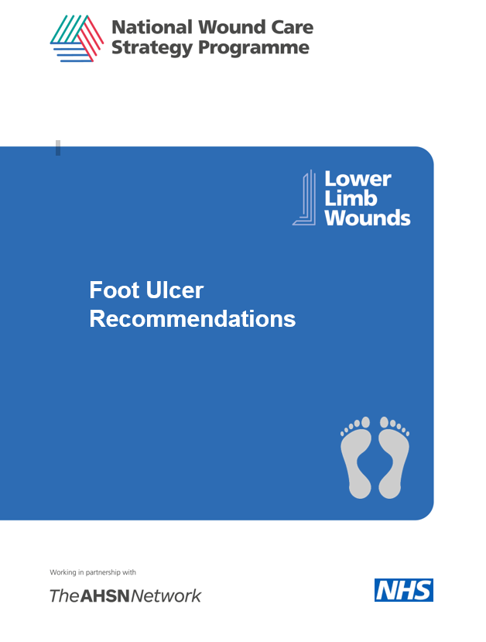


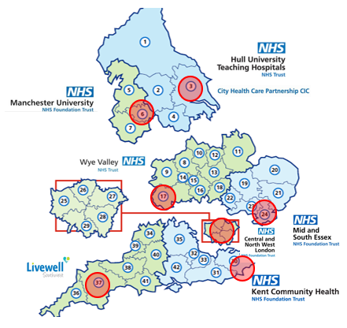
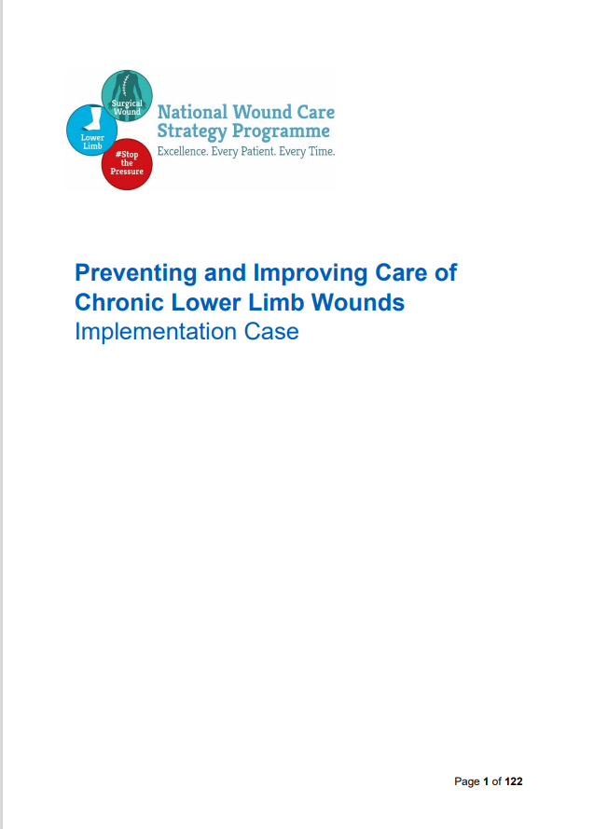
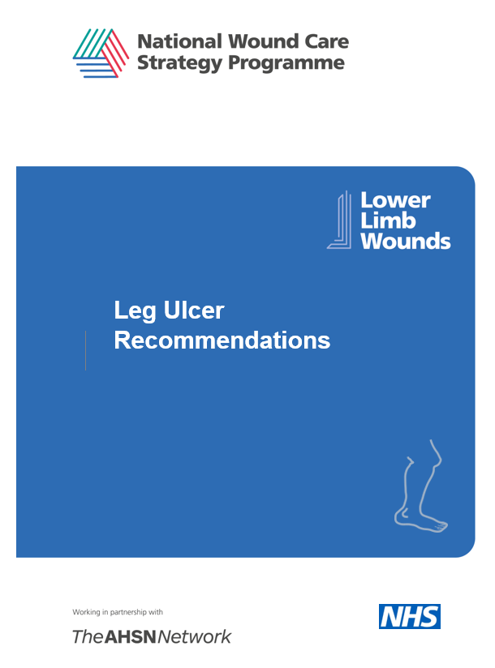

Lower Limb Wounds (Leg and foot ulcers)
Key action 8: Implement Leg Ulcer Best Practice Bundle

Slide 15


Pressure ulcers
Key action 9: Implement Pressure Ulcer Recommendations and improve pressure ulcer data
Coming soon........
Coded data acute care
Clinical coders code
Uploaded to Model Hospital System
Coded data community care
Clinicians record & analysts download
Mandated extracts uploaded to CSDS
Upload to Secondary Uses Services Dataset
Uploaded to Model community System

Slide 16


Surgical Wound Complications
Key action 10: Implement Surgical Wound Complications Recommendations and improve surgical wound complications data
Coded data acute care
Clinical coders code
Uploaded to Model Hospital System
Coded data community care
Clinicians record & analysts download
Mandated extracts uploaded to CSDS
Upload to Secondary Uses Services Dataset
Uploaded to Model community System
To be developed

Slide 17

In summary.... Key Actions
Aim for evidence-based good practice
Map the capabilities of whole workforce who care for people with wounds.
Address knowledge and skills gaps in the workforce
Identify opportunities for supported self-care
Optimise digital technology to support good clinical documentation, which results in quality data collection
Use data to improve data
Improve information about NHS product use
Implement Leg Ulcer Best Practice Bundle
Implement Pressure Ulcer Recommendations and improve pressure ulcer data
Implement Surgical Wound Complications Recommendations and improve surgical wound complications data

Slide 18



Connect with us
www.nationalwoundcarestrategy.net
NatWoundStrat
NatWoundStrat@mft.nhs.uk

